Slide 1
Live Training Module
Time Management For Leaders
Brett Davidson Founder

Slide 2
Effectiveness beats productivity

Slide 3
Productivity
(getting more things done)

Slide 4
Effectiveness
(getting the right things done)

Slide 5
Being effective is very bloody difficult

Slide 6
What’s your natural style?
(Do’er or procrastinator)

Slide 7
For the do’ers:
Spend 30 mins per fortnight on the three R’s:
Reflect
Refocus
Reinvention
Source: James Heale - Flywheel Learning

Slide 8
For the procrastinators:
Practice doing what you say you will do every day:
If you are not certain you’ll get it done, don’t commit to it
Commit to the things that are important
Review your performance every evening.
See How To Get Sh*t Done freebie on the website:
https://fpadvance.com/freebie/

Slide 9
Your Capacity Calculation

Slide 10
Then fill your diary
(full year, next quarter)

Slide 11
It’s scary how little time you have:
If the important stuff goes in first it’s easier to say ‘no’ to shiny things
If you don’t do this exercise, you kid yourself that it will all fit (it won’t)

Slide 12
I thought I was great at
“getting shit done”

Slide 13
We went travelling

Slide 14
Seville

Slide 15
What I Learned From Our Conversation
I wasn’t nearly as productive as I thought I was.
I had tasks hiding in four different locations.
Not being able to see everything allowed me to delude myself that I was on-it
Once I could see everything, I had difficult choices to make; what would, and what wouldn’t get done in my business.
Facing the truth allowed me to move on from being productive, to truly effective.
I needed to learn some new skills if I wanted to move up a level or two. Doing what I already knew how to do wouldn’t cut the mustard.

Slide 16
All of these insights probably apply to you too

Slide 17
How To Become Truly Effective
These new skills build on work we’ve done already:
Business planning
Weekly leadership meetings
Quarterly business reviews

Slide 18
The Four To Do Lists

Slide 19
1
In my to do list

Slide 20
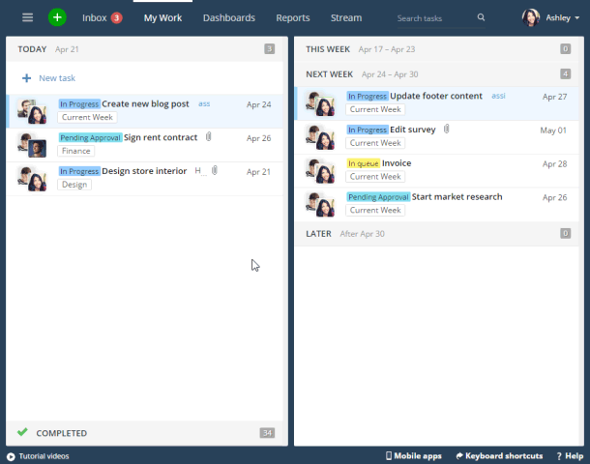
2
In my task sharing software (Wrike)

Slide 23
3
In my emails

Slide 24
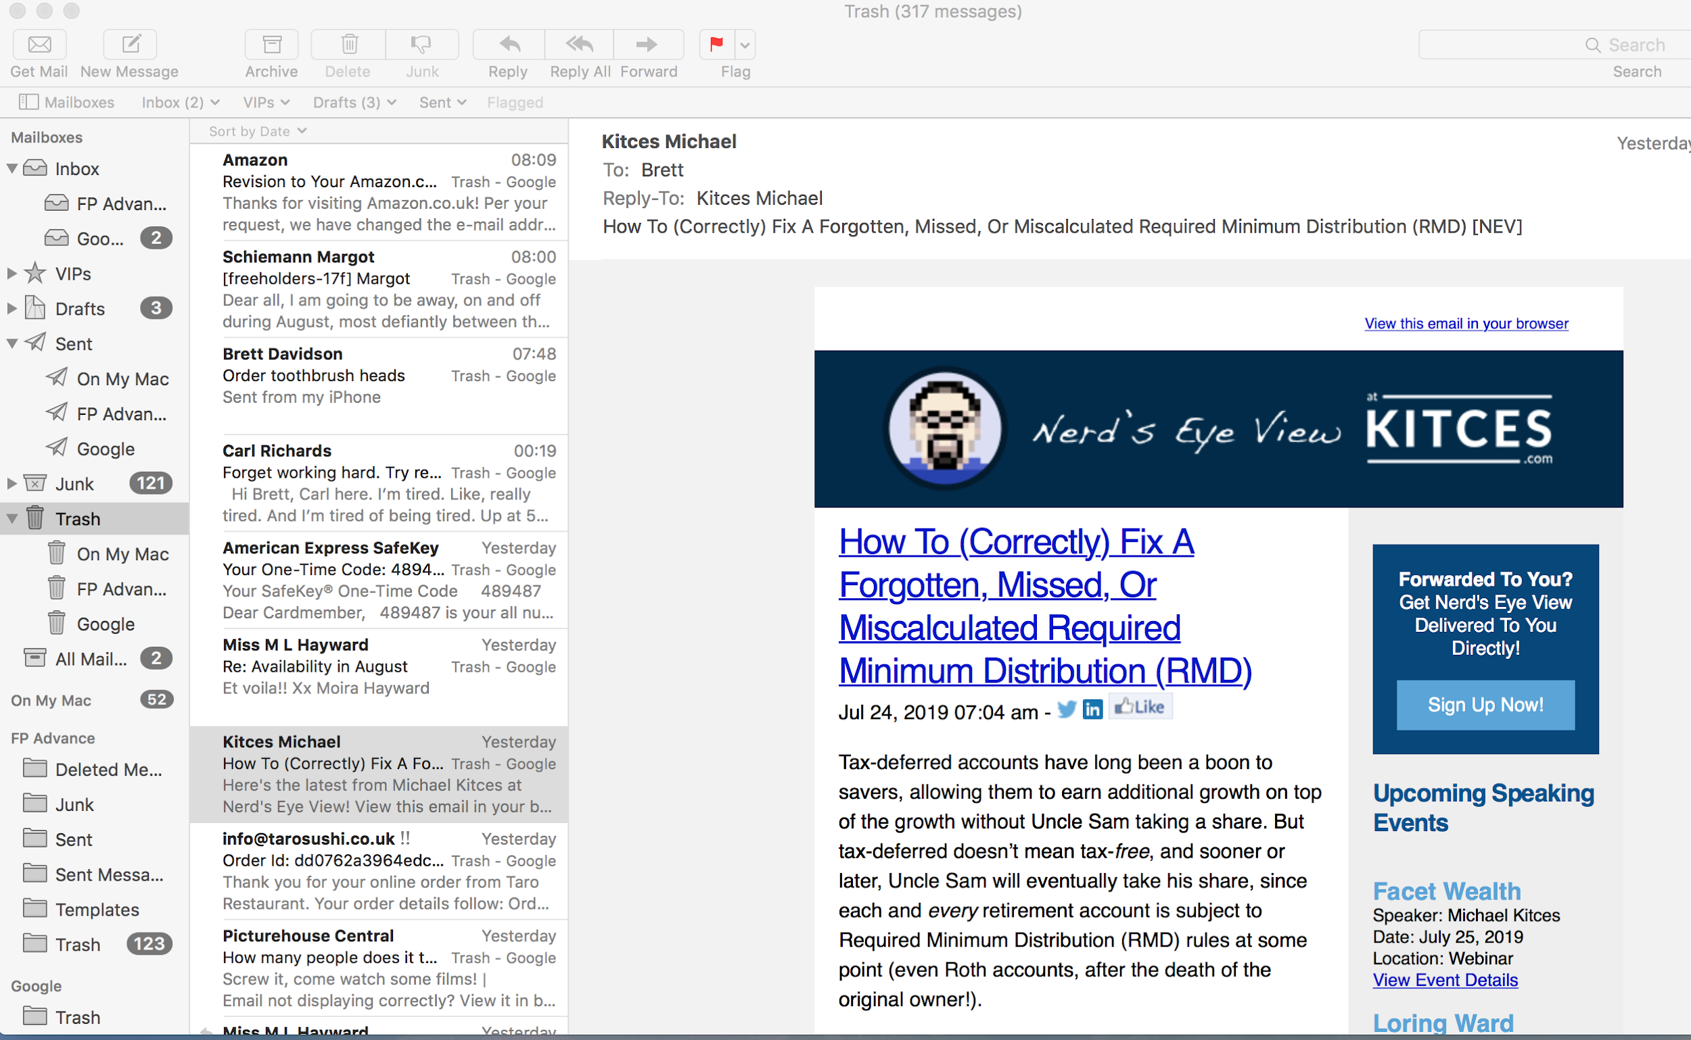

Slide 25
4
In my weekly leadership meeting

Slide 26
Why did I resist putting all of these to dos in one place?

Slide 27
Are you feeling the same sense of trepidation?

Slide 28
Task: Make a quick list of where you think your to dos hide

Slide 29
How was that for you?

Slide 30
Task: Create a master to do list

Slide 31
Sort Your Master List (Four categories)
Has to get done this week
High priority
If I get time
Probably never going to happen

Slide 32
How does it feel to see every
to do in one place?

Slide 33
This was a light bulb
moment for me

Slide 34
Planning Your Week

Slide 35
You can’t get it all done

Slide 36
Imagine you can only work 50% of your current hours

Slide 37
80%
How much of your current revenue
do you think you can generate?
70%
60%
50%

Slide 38
80%
How much of your current revenue
do you think you can generate?
70%
60%
50%

Slide 39
80%
How much of your current revenue
do you think you can generate?
70%
60%
50%

Slide 40
What do I spend
the other 50%
of my time on?

Slide 41
Planning Your Week

Slide 42
Prep-Step
Choose a regular time for planning your week

Slide 43
Monday morning?

Slide 44
Last thing Friday?

Slide 45
Sunday evening

Slide 46
Try to make it light and fun

Slide 47
Step 1:
Write down your quarterly goals

Slide 48
Step 2:
Clear your emails

Slide 49
a.)
Delete it

Slide 50
a.)
Delete it
b.)
Deal with it

Slide 51
a.)
Delete it
b.)
Deal with it
c.)
Turn it into a to do
(add it to your master to do list)

Slide 52
a.)
Delete it
b.)
Deal with it
c.)
Turn it into a to do
(add it to your master to do list)

Slide 53
a.)
Delete it
b.)
Deal with it
c.)
Turn it into a to do
(add it to your master to do list)

Slide 54
Step 3:
Check for any to dos from your weekly leadership meeting

Slide 55
Step 4:
Open your calendar or diary and ascertain time you have available for to dos this week

Slide 56
My calendar is already pretty full

Slide 57
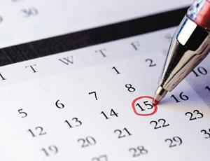
Make sure everything is in your calendar
(including travel time etc)

Slide 58
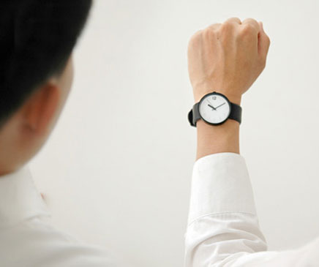
How many free hours do you truly have available?

Slide 59
Step 5:
Pick the important tasks that have to be done this week

Slide 60
Team GB Rowing:
“Will it make the boat go faster?”

Slide 61
Must it be done this week?

Slide 62
Must it be done this week?
If ‘Yes’...
Set it as a task for this week, or add it to a separate to do list for this week’s tasks

Slide 63
Must it be done this week?
If ‘No’...
Leave it on the master list,
or set it as a task for next week so you can’t see it anymore

Slide 64
Keep in mind a rough idea of how long each task might take

Slide 65
Does this have to be done by me?

Slide 66
Does this have to be done
by me?
If ‘No’...
Then delegate it, and write the name of the person you’re delegating it to next to the task

Slide 67
Does this have to be done
by me?
If ‘Yes’...
It’s yours!

Slide 68
Step 6:
Estimate how long each task will take

Slide 69
If you’re delegating...
how long will it take to delegate properly?

Slide 70
If you’re doing it yourself...
how long will it take?
(Be realistic or even conservative)

Slide 71
Three reasons
to allow more time:
It makes life and each task more enjoyable
Some jobs take longer than expected
You keep some slack in your day for your team or your clients

Slide 72
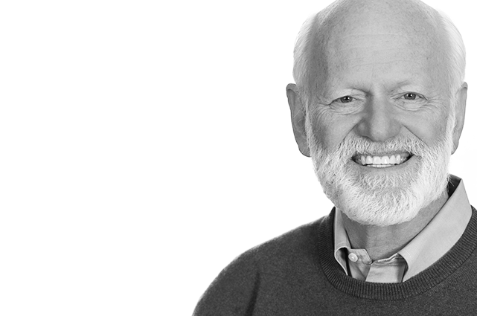
“I won’t get distracted today and nothing unexpected will happen. We don’t plan for the high probability of low probability events, like accidents, children not well enough to go to school, household headaches, stuck traffic, bad weather. And yet the odds of one of these is high.”
Marshall Goldsmith

Slide 73
I recommend scheduling in some time for your team throughout the day

Slide 74
Step 7:
Do the tasks fit within the time allocated?

Slide 75
Don’t skip this step!!!

Slide 76
Hours Available
Time Tasks Expected To Take
10 hours
2 hours

Slide 77
This ain’t gonna work!!!

Slide 78
Welcome to reality

Slide 79
You’ve got less time than you think...
so you have to choose

Slide 80
Prioritise the week’s tasks in order of importance

Slide 81
Hours Available
Time Tasks Expected To Take
Task 1
Task 2
Task 3
Task 4
Task 5
Task 6
Task 7
Task 8
Task 9
Task 10
Task 11
Task 12
Task 13
2 hours

Slide 82
Hours Available
Time Tasks Expected To Take
Task 1
Task 2
Task 3
Task 4
Task 5
2 hours

Slide 83
Step 8:
Identify your top 3 priorities for the week

Slide 84
Top 3 priorities this week:
____________________________
____________________________
____________________________

Slide 85
Top 3 priorities this week:
____________________________
____________________________
____________________________

Slide 86
Step 9:
Announce your one game-changer

Slide 87
Step 10:
Plan a reward for yourself

Slide 88
Weekly Planning Process
*Choose a regular time for planning your week
Write down your quarterly goals
Clear your emails
Check for any to dos from your weekly leadership team meeting
Open your calendar and ascertain the time you have available for to dos this week
Pick the important tasks that have to be done this week

Slide 89
Weekly Planning Process
6. Estimate how long each task will take
7. Do the tasks you’ve chosen fit within the time allocated?
8. Identify your top 3 priorities for the week
9. Announce your game-changer
10. Plan a reward for yourself

Slide 90
Planning Your Day

Slide 91
30 minutes in the morning?

Slide 92
The night before?

Slide 93
Run a zero email
inbox policy

Slide 94
Step 1:
Clear your emails

Slide 95
a.)
Delete it

Slide 96
a.)
Delete it
b.)
Deal with it

Slide 97
a.)
Delete it
b.)
Deal with it
c.)
Turn it into a to do
(add it to the correct to do list)

Slide 98
Step 2:
How much time do you have available today?

Slide 99
Step 3:
Pick the important tasks that can be done today

Slide 100
Warning:
Open your calendar or diary and ascertan time you have available for to dos this week
Do not skip this step!
Mark today’s tasks into your calendar, diary, or scheduler
(blocking out the estimated time, plus a bit, for each one)

Slide 101
Time
Task
9:00 - 10:00
Team meeting
10:00 - 12:00
1st Meeting with Mr & Mrs Smith
12:00 - 13:00
Complete Meeting notes from Mr & Mrs Smith mtg
13:00 - 13:30
Lunch
13:30 - 14:00
Draft marketing invitation for upcoming client event
14:00 - 16:00
1st Meeting with Mr & Mrs Jones
16:00 - 17:00
Complete Meeting notes from Mr & Mrs Jones mtg
17:00 - 18:00
Respond to 3 existing client queries via email
*Existing diary commitments
*Tasks I’ve added today

Slide 102
You can’t get it all done

Slide 103
Time
Task
9:00 - 10:00
Team meeting
10:00 - 12:00
1st Meeting with Mr & Mrs Smith
12:00 - 13:00
Complete Meeting notes from Mr & Mrs Smith mtg
13:00 - 13:30
Lunch
13:30 - 14:00
Draft marketing invitation for upcoming client event
14:00 - 16:00
1st Meeting with Mr & Mrs Jones
16:00 - 17:00
Complete Meeting notes from Mr & Mrs Jones mtg
2 hours
17:00 - 18:00
Respond to 3 existing client queries via email
*Existing diary commitments
*Tasks I’ve added today

Slide 104
Time
Task
9:00 - 10:00
Team meeting
10:00 - 12:00
1st Meeting with Mr & Mrs Smith
12:00 - 13:00
Complete Meeting notes from Mr & Mrs Smith mtg
13:00 - 13:30
Lunch
13:30 - 14:00
Draft marketing invitation for upcoming client event
14:00 - 16:00
1st Meeting with Mr & Mrs Jones
16:00 - 17:00
Complete Meeting notes from Mr & Mrs Jones mtg
17:00 - 18:00
Respond to 3 existing client queries via email
*Existing diary commitments
*Tasks I’ve added today

Slide 105
Time
Task
9:00 - 10:00
Team meeting
10:00 - 12:00
1st Meeting with Mr & Mrs Smith
12:00 - 13:00
Complete Meeting notes from Mr & Mrs Smith mtg
13:00 - 13:30
Lunch
13:30 - 14:00
Draft marketing invitation for upcoming client event
14:00 - 16:00
1st Meeting with Mr & Mrs Jones
16:00 - 17:00
Complete Meeting notes from Mr & Mrs Jones mtg
17:00 - 18:00
Respond to 3 existing client queries via email
*Existing diary commitments
*Tasks I’ve added today

Slide 106
Top 3 priorities this week:
____________________________
____________________________
____________________________

Slide 107
Top 3 priorities this week:
____________________________
____________________________
____________________________

Slide 108
Step 4:
Work the day as planned

Slide 109
30 minutes in the morning

Slide 110
Post on the Forum if you have any issues

Slide 111
What I Learned From Doing This Myself
I wasn’t nearly as productive as I thought I was.
I had tasks hiding in four different locations.
Not being able to see everything allowed me to delude myself that I was on-it
Once I could see everything, I had difficult choices to make; what would, and what wouldn’t get done in my business.
Facing the truth allowed me to move on from being productive, to truly effective.
I needed to learn some new skills if I wanted to move up a level or two. Doing what I already knew how to do wouldn’t cut the mustard.

Slide 112
This approach will change your life

Slide 113
Deep work vs. shallow work

Slide 114
Deep work
(No interruptions, phones, emails)

Slide 115
Deep Work by Cal Newport

Slide 116
Get free of social media and online news

Slide 117
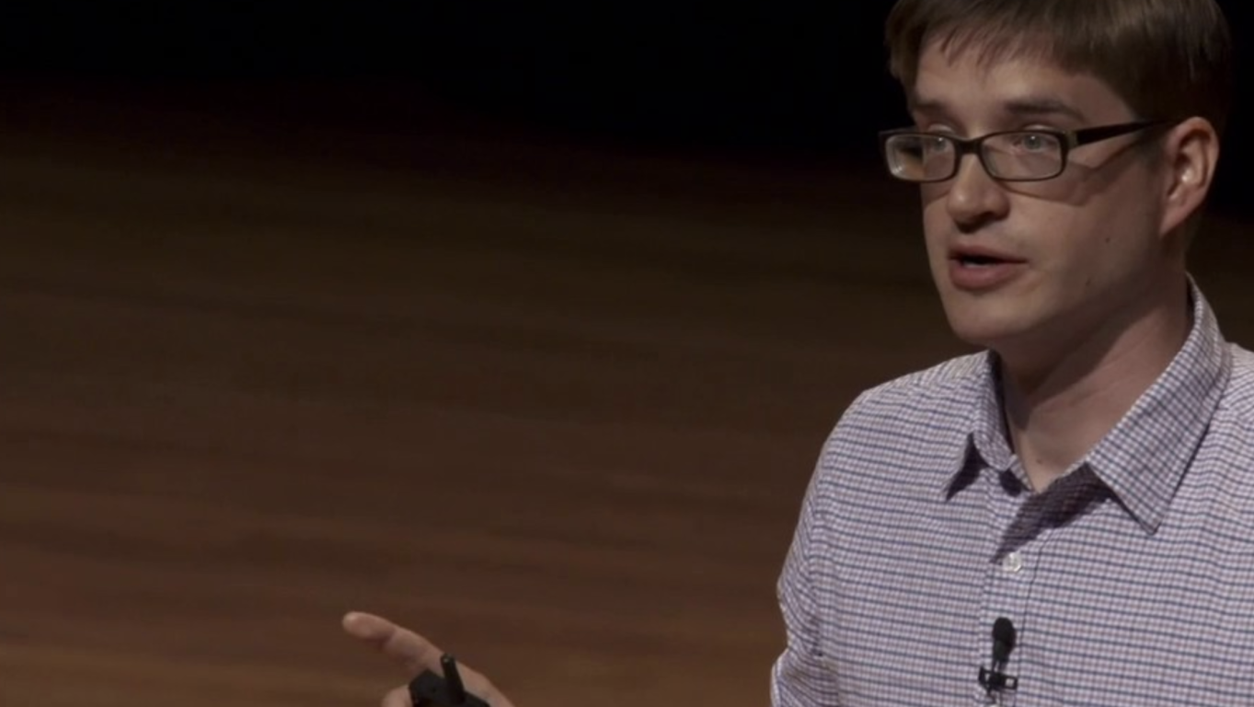
Plan the right “deep work to shallow work” ratio

Slide 118
What Are The Benefits?
Leaving social media and online news increases boredom
If you can sit with the boredom you’ll generate better ideas - for work and for your life
You’ll work less hours and get more done
You’ll create tight boundaries between work time and family time
Important stuff gets planned in advance - so it gets done

Slide 119
What Are The Benefits?
6. You feel like you’re building a better business and a better life
7. It’s very fulfilling - because it’s bloody hard
8. It’s the difference between mediocrity and achieving your dreams
9. Each day is lower stress and more fun
10. You feel like you can sustain this effort for the next 10-20 years

